Slide 1
secure data hiding in image using stegnography
CAPSTONE PROJECT
Presented By:
Student Name : PURNA KARTHIK TADI
College Name & Department : DR A P J ABDUL KALAM RGUKT IIIT ONGOLE CAMPUS , AP & COMPUTER SCIENCE ENGINEERING

Slide 2
OUTLINE
Problem Statement
Technology used
Wow factor
End users
Result
Conclusion
Git-hub Link
Future scope

Slide 3
Problem Statement
With the rise of digital communication, protecting sensitive information from unauthorized access is crucial. Traditional encryption secures data but does not hide its existence, making it vulnerable to attacks. This project aims to implement a secure steganography technique to conceal text messages within images using the Least Significant Bit (LSB) method. A password-based decryption mechanism will ensure that only authorized users can retrieve the hidden data.

Slide 4
Technology used
Libraries Used :
OpenCV
OS
String
Tkinter
Platforms :
Operating System : Ubuntu 22.04
Interpreter : Python3.10.12 Interpreter

Slide 5
Wow factors
1.Dual-Layer Security (Steganography + Password Protection) :
Unlike basic steganography projects, this system not only hides messages within an image but also requires a password for decryption, adding an extra layer of security.
2.Least Significant Bit (LSB) Optimization :
The implementation ensures that image quality remains unchanged, making the hidden message undetectable to the human eye.
3.Customizable Encoding Approach :
Supports different encoding techniques (e.g., LSB, bit-plane slicing) to improve robustness against compression or editing.
4.Steganalysis Resistance :
Designed to minimize statistical anomalies, making it difficult for attackers to detect hidden data through steganalysis techniques.

Slide 6
End users
1.Cybersecurity Professionals & Ethical Hackers :
Use steganography to securely transmit sensitive data without detection.
2.Government & Intelligence Agencies :
Secure classified communication without attracting attention.
3.Corporate Organizations :
Protect trade secrets and confidential business information.
4.Military & Defense :
Enable covert communication during operations.
5.Forensic Experts :
Embed digital watermarks in images for tracking and authentication.
6.General Users (Privacy Enthusiasts) :
Hide personal information or passwords in images to prevent unauthorized access.

Slide 7
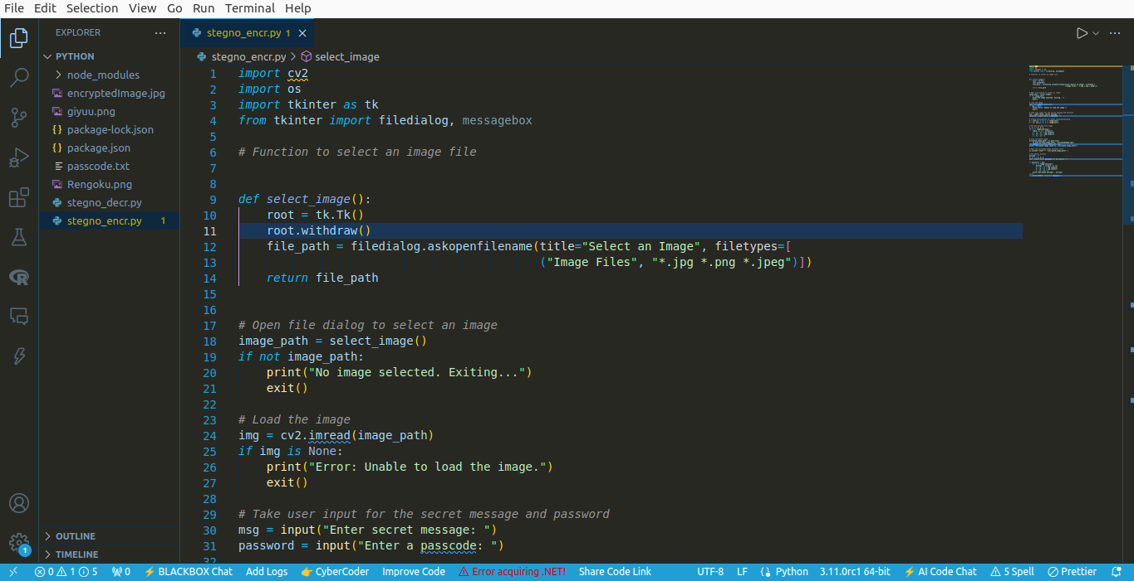
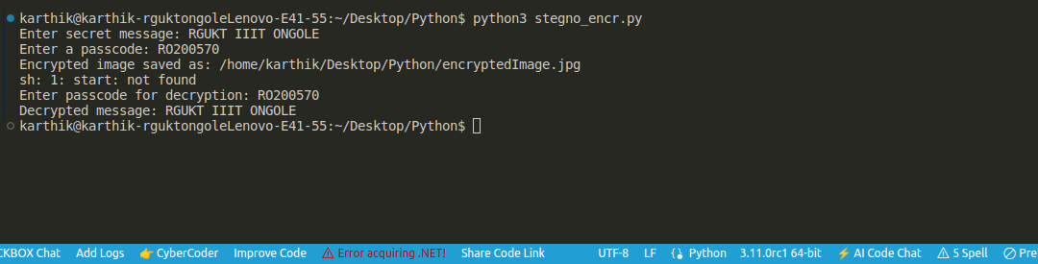
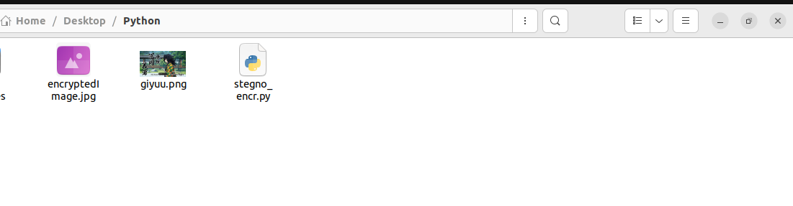
Results

Slide 8
Conclusion
The Secure Data Hiding Using Steganography project successfully implements a technique for embedding secret messages within images while ensuring imperceptibility, security, and robustness. By combining Least Significant Bit (LSB) steganography with password-based access control, the project enhances the confidentiality of hidden information. The system maintains the original image quality while providing a secure means of communication, making it useful for cybersecurity professionals, journalists, corporate organizations, and government agencies.

Slide 9
GitHub Link
https://github.com/Purnakarthik/Stegnography.git

Slide 10
Future scope(optional)
Advanced Encryption Techniques :
Integrate AES (Advanced Encryption Standard) or RSA encryption before embedding the message for enhanced security.
Support for Multiple Media Formats :
Extend steganography beyond images to audio, video, and text files, increasing versatility.
Steganalysis Resistance :
Implement adaptive steganography techniques to prevent detection by steganalysis tools.
Cloud-Based Secure Communication :
Develop a cloud-based system for securely sharing steganographic images over the internet.

Slide 11
THANK YOU

